Slide 1
Cryptographic Hash
Authentication Protocol
Digital Signatures
Adopted from “Cryptography and Network Security” by W. Stallings

Slide 2
Contents
Function, requirements & application of digital signatures
How is digital signature implemented
Type of digital signatures
Digital Signature Scheme and standards

Slide 3

Digital Signature
Message authentication
through Hash, MAC or encryption
but does not address issues of lack of trust
Handwritten Signature (useless on internet)
Bind signatory to the message
The signature provides:
Authentication of the message content
3rd parties (not just the receiver) could verify
Author , Date (& Time) of message
→ Non repudiation
Notes:
lack of trust is not addressed by HMAC or encryption: Message authentication protects two parties who exchange messages from any third
party. However, it does not protect the two parties against each other. Several forms of dispute between the two are possible.
Consider Mary and John are exchanges messages with MAC authentication. (but they are not honest persons.)
1. Mary may forge a different message and claim that it came from John. Mary
would simply have to create a message and append an authentication code
using the key that John and Mary share.
2. John can deny sending the message. Because it is possible for Mary to forge a
message, there is no way to prove that John did in fact send the message.

Slide 4
Digital Signature Requirements
In situations where there is no complete trust between sender and receiver, something more than authentication is needed.
Must be a bit pattern that depend on the message signed
Must use information unique to sender
to prevent both forgery and denial
Must be relatively easy to produce
Must be relatively easy to recognize & verify
Should be computationally infeasible to forge
Create new message with an existing digital signature
Create a fraudulent digital signature for given message
Should be practical to save digital signature in storage

Slide 5
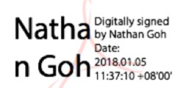

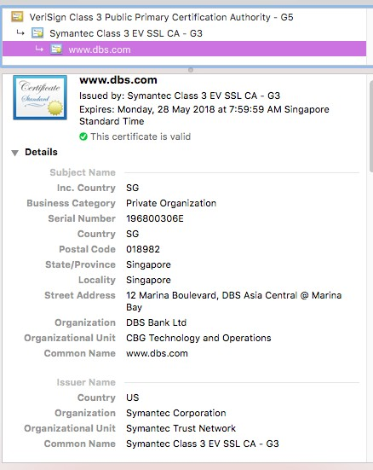
Application of Digital Signature
Use to sign documents, ﬁles, emails (i.e. PDF, Word, PGP email)
Use to sign server‘s certificate
Provide as a online signing service (i.e. DocuSign)
how it works ?
Ref : www.docusign.com

Slide 6
How Digital Signature works
Digital Signature - An authentication mechanism that enables the creator of a message to attach a code that acts as a signature. The signature is formed by taking the hash of the message and encrypting the hash with the creator’s private key. The signature guarantees the source and integrity of the message
Generic Model of Digital Signature Process

Slide 7
Type of Signatures
Direct Digital Signatures
Arbitrated Digital Signatures

Slide 8
Direct Digital Signatures
Involve only sender & receiver
Assumed
Sender and receiver have their own key pairs. (private and public keys)
Receiver has sender’s public-key
Sender has receiver's public-key
Sign ﬁrst then encrypt message & signature
Digital signature made by sender’s private-key either
Sign (encrypt) entire message
Sign (encrypt) hash only : For efficiency of the scheme
Notes:
Special Attention Required

Slide 9
Direct Digital Signatures
Encrypt using receiver’s public-key
Validity of signature depends on sender’s private-key
Sender may deny sending the message
Private Key Stolen
Timestamp on message is not useful
Message might be back dated
Notes:
Special Attention Required

Slide 10
Arbitrated Digital Signatures
Implementing an arbitrated digital signature invites a third party into the process called a "trusted arbiter."
Use of a arbiter (trusted 3rd party)
Arbiter receive signed messages from sender
Validate content & origin from subject, message and signature
Arbiter dated the message and indicated that the message have been veriﬁed
Sent to recipient(s)
Notes:
Special Attention Required
Please remind the class that Arbitrated Digital Signatures and Digital Certificates both can provide similar digital signature verification process among two 'untrusted parties'. Both of the schemes based on PKI (Public Key Infrastructure), however, Digital Certificates scheme does not require the signed messages to be sent to any trusted 3rd party for the verification process.

Slide 11
Arbitrated Digital Signatures
Arbiter may or may not see the message.
Suitable level of trust in arbiter required.
Implemented together with private or public- key encryption. Need:-
Complete trust from both the sender and receiver that the arbiter will not only time-stamp and forward the document as instructed, but also not alter the data in any way.
Prevent sender from disowning message
Notes:
Special Attention Required

Slide 12
Digital Signature Schemes

Slide 13
Mechanism of Signature Schemes
The scheme deﬁnes these 3 algorithms
Key generation algorithm
Randomly select a key pair
Signature algorithm
Message + Private key → Signature
Signature verification algorithm
Public key + Signature → True / False (Validated / Not Validated)

Slide 14
Digital Signature Standard (DSS)
US Govt approved signature scheme
designed by NIST & NSA in early 90's
published as FIPS-186 in 1991
– revised in 1993, 1996 & then 2000
Uses the SHA hash algorithm
DSS is the standard, DSA is the algorithm
* FIPS 186-2 (2000) includes alternative RSA & elliptic curve signature variants
14

Slide 15
Digital Signature Algorithm (DSA)
Based on Asymmetric Key Algorithm
A digital signature scheme
320 bit signature (length of signature),
512-1024 bit security (key)
Smaller & faster than RSA
Security → discrete logarithm (computationally hard problem)
Optional Reading
http://www.herongyang.com/Cryptography/DSA-Introduction-What-Is-DSA- Digital-Signature-Algorithm.html or your textbook
15
Notes:
http://www.herongyang.com/Cryptography/DSA-Introduction-What-Is-DSA-Digital-Signature-Algorithm.html
DSA(Digital Signature Algorithm) can only be used for signing/verification, whereas RSA can be used for encryption/decrypt as well.
DSA uses Discrete logarithm. RSA uses Integer Factorization.

Slide 16
Digital Signature Algorithm (DSA) - 1
Key Generation – By the signing person
Domain Parameters : p, q , g
Prime number (p) →2^{L-1} < p < 2^{L}
– L (bit length of p) = 512 ≤ L ≤ 1024 (original)
– L in multiple of 64 (i.e. 512, 576,..1024)
– If L = 1024, then p, a prime number is 2¹⁰²³ < p < 2¹⁰²⁴
Prime divisor (q) – A N bits prime number
- N (bit length of q) = 160 (original)
Generator (g) = h^{(p-1)/q} mod p
where h is any random integer with 1 < h < (p - 1)
and h^{(p-1)/q} mod p > 1
DSA Standard (2013) : acceptable L, N pairs
(1024, 160), (2048, 224), (2048, 256), or (3072, 256)
Notes:
http://www.herongyang.com/Cryptography/DSA-Introduction-Algorithm-Illustration-p7-q3.html

Slide 17
Digital Signature Algorithm (DSA) - 2
Generation of per user keys
User’s Private Key (x)
x →random integer, 0 < x < q
User’s Public Key (y)
y = g^{x} mod p
User’s Per-message secret Number (k)
k→ random integer, 0 < k < q
k should never be reused

Slide 18
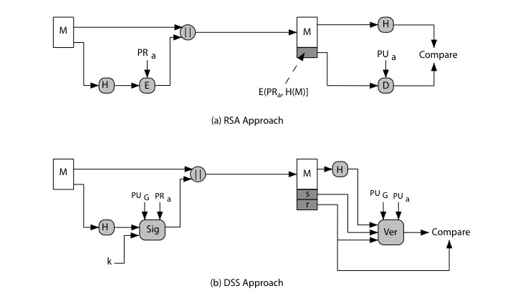
Digital Signature Algorithm (DSA)
PU_{G} = A global public key
v
r,s
If v = r, then authenticated
Signature Creation
Signature Verification

Slide 19
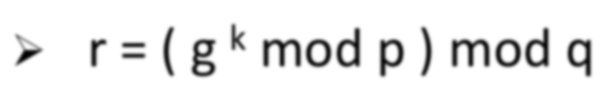
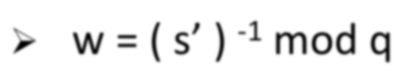
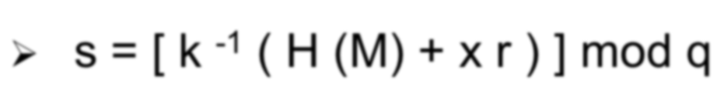
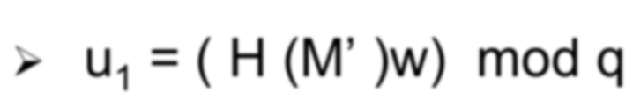
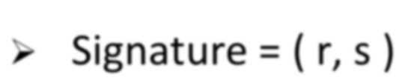
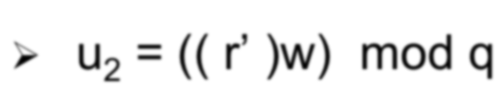
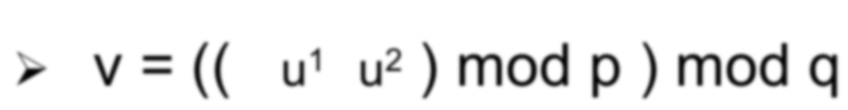
Digital Signature Algorithm (DSA)
SIGNING (Signature Creation)
Requires p,q,g,x,k, M
r = ( g ^{k} mod p ) mod q
s = [ k ⁻¹ ( H (M) + x r ) ] mod q
Where x is the private key
Signature = ( r, s ) is sent with message M
VERIFICATION (on receiving end)
Requires p,q,g,y,M',s',r'
w = ( s’ ) ⁻¹ mod q
u₁ = ( H (M’ )w) mod q
u₂ = (( r’ )w) mod q
v = (( _{g}u¹_{y}u² ) mod p ) mod q
Where y is the public key of sender
k ⁻¹ mod q
denotes a modular inverse computation
Test: v = r ’
M =
H(M) =
message to be signed
hash of M using SHA-1 or 2 received version of M, r, s
M’ , r’ , s’=
Notes:
M', r' and s' denote what have been received by the receiver.
Hopeful that, M' = M , r' = r and s' = s.
Then v should be equal to r'

Slide 20
Summary
Digital Signature (DS) is used to ensure authentication and Non-repudiation of the message.
Digital Signature could be used directly or arbitrated.
Schemes are deﬁned based on their key generation, signature algorithm and signature verification algorithm.
DSS schemes (US government standard) based on DSA *algorithm) is discussed.
19
Notes:
Special Attention Required
The DSA has been discussed only. Not explained in detail. Therefore, the detail operations of DSA will not be included in the examination paper.

